Slide 1
Human crowds as an ideal gas
Ondertitel? Namen+rnummers?

Slide 2
Introduction
Human Crowds exhibit both structured and chaotic behaviors
Two perspectives:
Microscopic
Macroscopic
Can crowds behave like an ideal gas under certain conditions?
Notes:
​When we think of human crowds, we often picture people moving in an organized manner, like forming lanes in pedestrian traffic. But under stress, such as in an evacuation, crowds can behave chaotically, leading to jams and dangerous situations.
Traditionally, researchers approach crowds in two ways: from a microscopic perspective, where individuals follow certain rules, or from a macroscopic perspective: where we study group-level behavior without focusing on individuals.
However, a surprising question arises: Can we describe crowd movement using the laws of thermodynamics, similar to how we describe gases? Some studies have hinted at equilibrium-like behavior in crowds, but the exact conditions were unclear.
This research investigates when and why crowds behave like an ideal gas.
The key finding is that under high pressure, crowd behavior becomes more predictable, following an equation similar to the ideal gas law.
In the next sections, we’ll explore the experimental data, modeling approaches, and the implications of these findings."

Slide 3
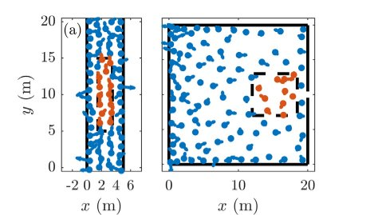
Methods Experimental
Experimental methods
People
Individual speed
Bottleneck evaluation (type 1)
Unidirectional flow (type 2)
Notes:
​Dingen die Annabelle gebruikt en verduidelijkt moeten worden:​
-individual speed (= de v_i onder modelling?)​
-2 soorten experimenten : bottleneck evacuation en unidirectional flow (In orde)​
​
Data van eerdere exeperimenten (references 21 & 22): videos; trajectories aangeuid (zie image) -> velocity time series via Gaussian derivative kernel (references 23-25)​
Wtf is een Gaussian derivative kernel???!!! Internet is echt useless​
​
​

Slide 4



Methods Modeling
Model → acceleration
Interactions
Desired speed
Relaxation time
Potential
Helbing-Molnar
Lennard-Jones
Notes:
Waarom maakt deze paper het zo verdomd moeilijk info te vinden​
​
Modelling data: Helbing-Molnar model & Social Distance model (references 26 & 20)​
F_ij = repulsive interaction​
F_iW = interaction with wall​
v^d = desired speed​
Tau = relaxation time​
​
-Helbing-Molnar: exponential potential​
​
-Social Distance: Lennard-Jones-like potential​
​
Bottleneck: 100 individuals in 20x20 m² room, door 0.92 m width​
Unidirectional flow: 100 individuals in 20 m long corridor, 5 m width​

Slide 6
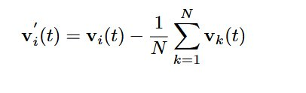
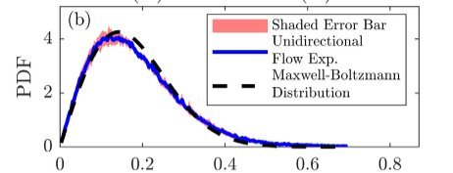

Equilibrium in crowds Maxwell-Boltzmann
Fluctuating velocity
Interrogation area
$v_{i}^{′}(t)$ → PDF
Maxwell-Boltzmann distribution​
Notes:
Problem: could a human croud be in equilibrium, and if so, under wich circomstances​
Instantanous velocity does not incorporate interaction between individuals -> fluctuation velocity (diffrence between individual velocity and mean velocity and the group)​
​
Image: - snapchot of a group in a confined area​
- dot (people) , arrow (individual fluctuation velocity)​
- Interrogation area -> selected region where indivual fluctuating velocity is converted to a probability density function ​
For various cases the PDF has been consrutcted​
Graph -> avaraged PDF , fitted to a 2D maxwel boltzmann distribution​
Pink area: 95% confidence interval that a single PDF is situated in this area​
​

Slide 7
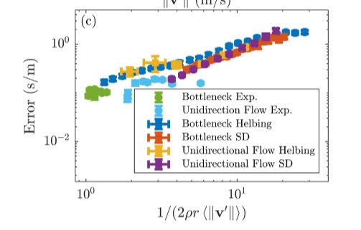
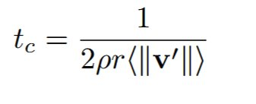
Equilibrium in crowds Collision time
Various experimental situations
Intervals of the same collision time
Notes:
Collision time: 'avarage time between to distinct collision of individuals'​
Explanation formula (kan eventueel niet uitgelegd worden in de hoop dat iemand dit als vraag stelt): ​
1/ collision frequency​
- 2r : collision cross section of individuals (r mean distance between individuals)​
Ro: crowd density​
When the collsion time decreases -> mean squared error between best fit and PDF decreases ​
​
PROBLEM STATING:​
Human croud -> inherently non-equilibrium system (convert internal energy into motion)​
Maxwell boltzman distribution applies for systems in equilibrium​
​
​
​

Slide 8

Equilibrium in crowds Canonical ensemble
Conditions canonical ensemble:
Constant V, T, N
Canonical ensemble:
Individual → System
Crowd → Reservoir
Temperature
Notes:
High amount of collision (implicates small collision time) -> constant temperature because more frequent exchange in energy between system and reservoir​
Sufficient amount of collsions before significant temperature change => system wil mimic a equilibrium where the conditions of the canonic ensemble are satisfied​
Nut?

Slide 9
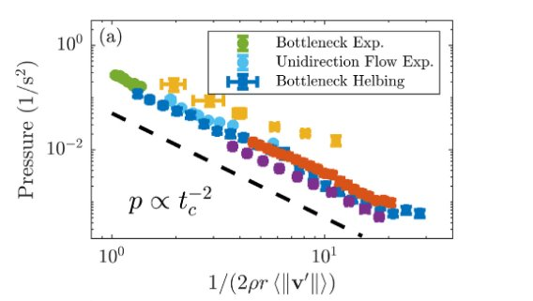
Equilibrium in crowds State variable
High pressure → Equilibrium

Slide 11

Ideal gas law
Maxwell-Boltzmann → $pA=nk_{B}T$
Heat capacity
$A=cte$: $C_{A}=k_{B}N$
$p=cte$: $C_{p}=2k_{B}N$
No phase transition
Notes:
#Applications:​
Estimate number individuals in crowd​
Predicts dangerous situations​

Slide 12
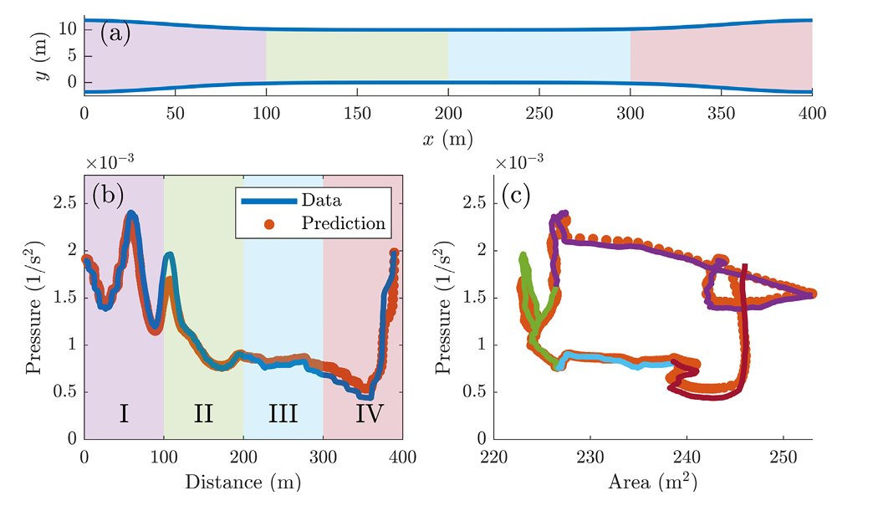
Ideal gas law Applications
Notes:
Phase transition , verduidelijken wat dit betekend voor mensen​
Extra slide met normale engine

Slide 13
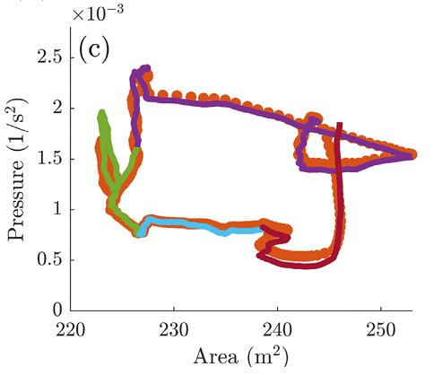

Slide 14
Discussion
Kinematic pressure → Dynamic pressure
Analogies + extra variable
Notes:
We definieren pressure kinematically -> geen fase, meer onderzoek, of viriaaltermen er zijn​
Analogies with gasses ONDER HOGE DRUKKEN, meer onderzoek naar meer (extra) variabelen, waaronder de eerste en tweede wet​
​
Application: eens kijken hoe je Hiermee beter een festivalterein opbouwt/een gang maakt

Slide 15
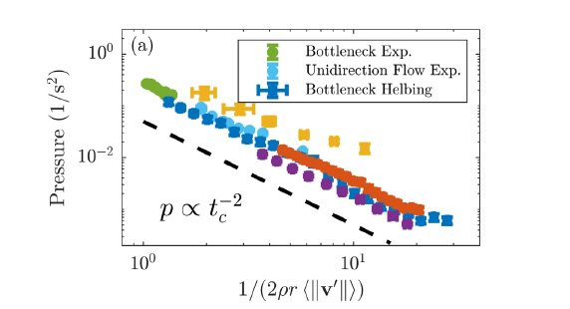
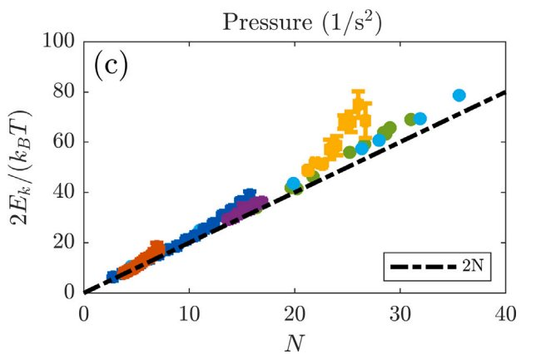
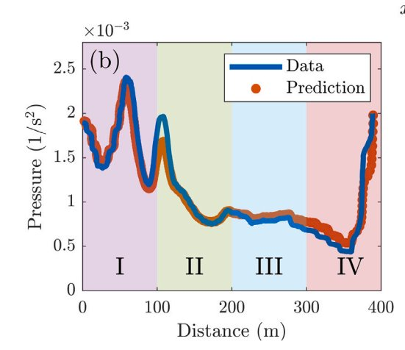
Conclusion
Human crowds can effectively be modeled as an ideal gas
Further research is needed to refine the model and its applications.

